Slide 1

V Semester Artificial Intelligence and Machine Learning Open-Ended Project Work (21AI52)
Department of Computer Science & Engineering,
RV College of Engineering, Bengaluru.

Slide 2

In a Heart Beat: Heart Attack Prediction Model integrated in a user-friendly website Hardik Hiraman Pawar – 1RV21CS046 Karan Sathish – 1RV21CS058
Faculty Incharge1 (Theory) :
Prof. Suma B (CSE)
Faculty Incharge2 (Lab) :
Prof. Krishnappa H. K.

Slide 3
Agenda
Identification of Problem Domain and Detailed Analysis
Literature Review
Research gap
Objectives
Methodology

Slide 4
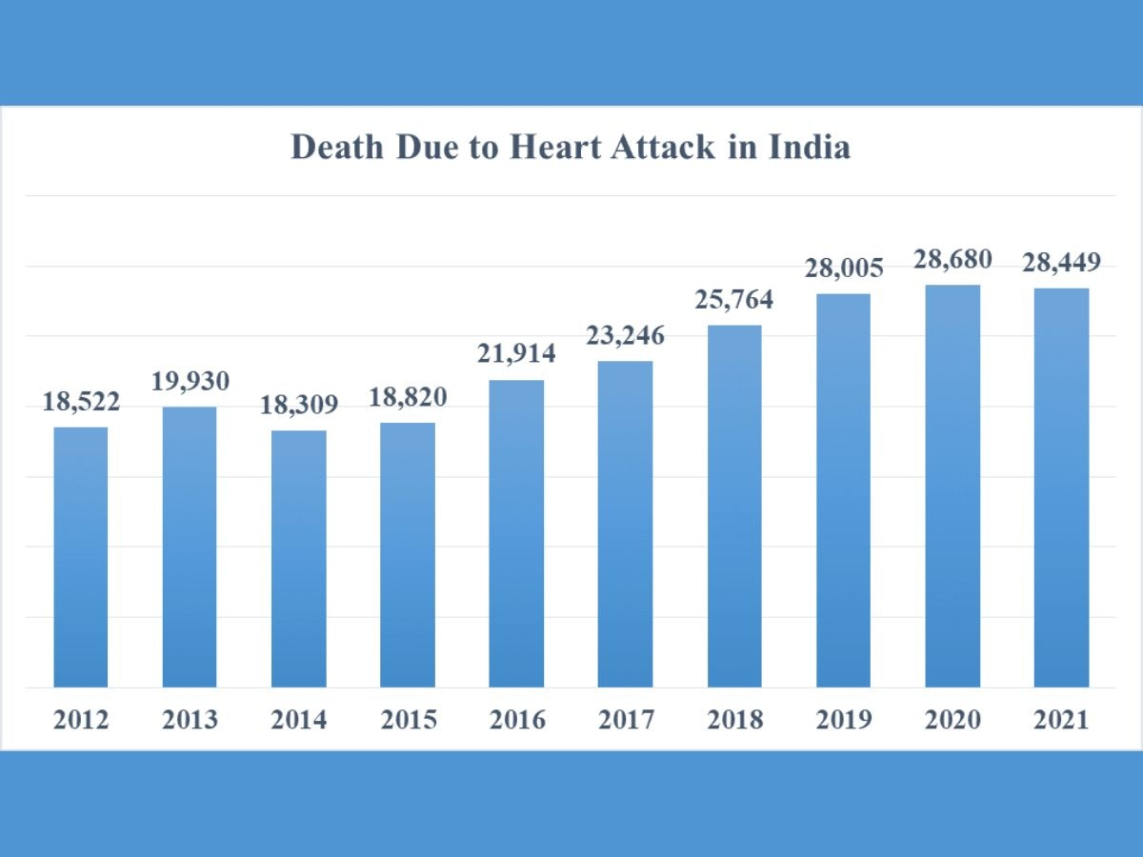
Identification of Problem and Detailed Analysis
Problem domain
The domain of concern revolves around the increasing incidence of heart attacks, exemplified by a stark rise in related fatalities, with approximately 28,449 reported deaths due to heart attacks in India alone. Recognizing the gravity of this health issue, our focus is on providing a solution that is both proactive and user-friendly.

Slide 5

Identification of Problem and Detailed Analysis
Potential for AI in the problem domain with industrial relevance
In leveraging deep learning and web development, our project, "In a Heart Beat," harnesses the potential of Artificial Intelligence (AI) to predict the likelihood of a heart attack. This amalgamation holds industrial relevance by bridging the gap between advanced predictive modeling and user accessibility through an interactive website.

Slide 6
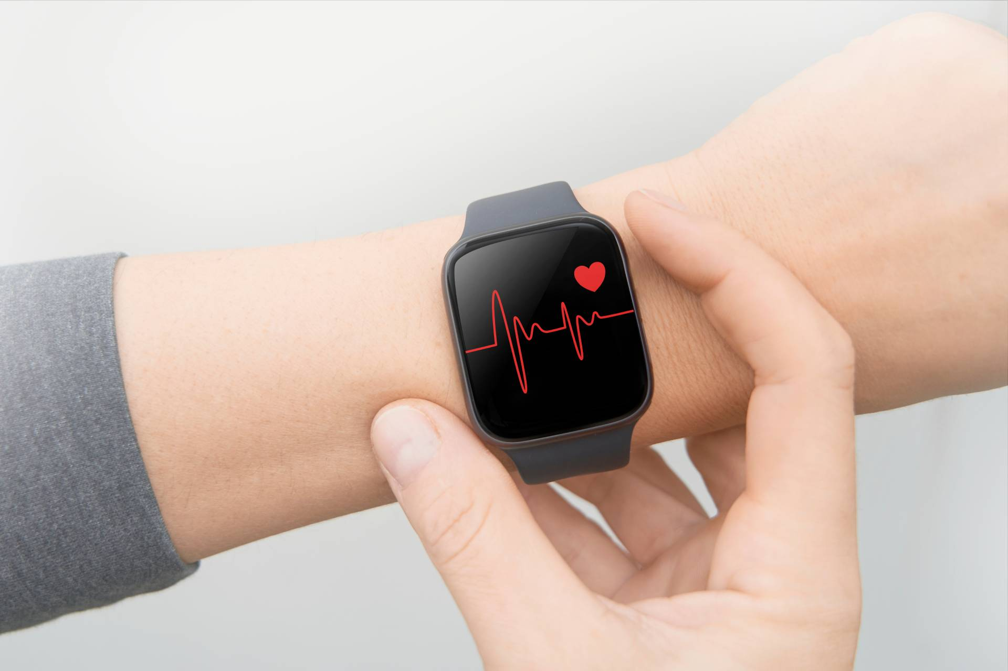
Identification of Problem and Detailed Analysis
Statement of the problem
The primary challenge addressed by our project is the apprehension and reluctance of individuals to seek medical help in traditional clinical settings. "In a Heart Beat" seeks to mitigate this issue by offering a non-intrusive and comfortable alternative. Users input their vital medical details, such as oxygen levels and heart rate, into our interactive website, where a pre-trained machine learning model predicts the likelihood of a heart attack.

Slide 7
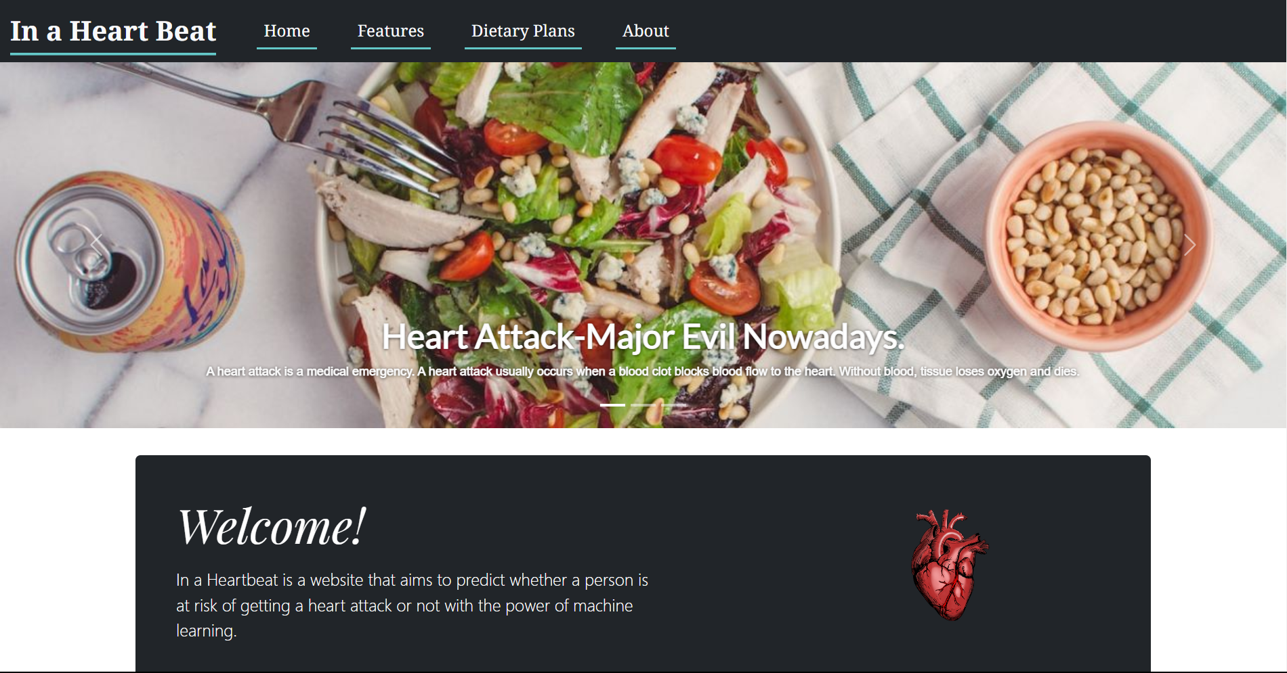
Identification of Problem and Detailed Analysis
Detailed and extensive explanation of the purpose & uniqueness of the project
The purpose of "In a Heart Beat" is twofold. First, it aims to provide individuals with a user-friendly platform to assess their risk of a heart attack without the discomfort associated with traditional healthcare environments. Second, it introduces an innovative integration of deep learning techniques and web development to enhance predictive accuracy.
The uniqueness of our project lies in its ability to seamlessly blend advanced AI algorithms with a straightforward and accessible interface. Users can easily navigate the website, input their medical data, and receive accurate predictions regarding their risk of a heart attack. By combining cutting-edge technology with user-centric design, "In a Heart Beat" stands out as a progressive solution addressing a critical health concern.

Slide 8
Literature Review
Information is to be gathered from multiple, research-based sources (around 20 RECENT research publications in Referred journals/ Conferences ).
Well organized, demonstrative logical sequencing and structure.

Slide 9
Literature Review
Sl. No | Title of the work | Author/s and Publication details | Objectives of the work carried out | Results Obtained | Gaps Identified
RECENT PAPERS FIRST 2024 to 2020

Slide 10
Research gap
Identify the Research gap in the Literature review pertaining to your project.

Slide 11
Objectives
1. Develop a Robust Predictive Model
The primary objective of this project is to create a highly accurate and reliable predictive model for assessing the risk of heart attacks. This involves employing deep learning techniques, specifically neural networks, to analyze a comprehensive dataset and generate predictions based on user-input medical details.
2. Create an Intuitive User Interface
To ensure widespread accessibility, the project aims to design an intuitive and user-friendly website. The interface should be easily navigable, allowing individuals, regardless of technical proficiency, to input their medical information seamlessly and receive clear and understandable predictions.
3. Enhance Model Training and Generalization
Continuous improvement of the predictive model is essential. The project will focus on refining the model through iterative training processes, incorporating user feedback, and ensuring its adaptability to diverse datasets. The goal is to enhance the model's generalization capabilities for a broader user demographic.

Slide 12
Objectives
4. Provide Clear Interpretability of Results
Transparency in presenting the results is a key objective. The project will focus on developing features that allow users to understand the basis of the predictions, providing insights into the factors contributing to the calculated risk. Clear interpretability fosters user trust and confidence in the system.
5. Solicit User Feedback and Iterative Improvement
Actively engaging with users to gather feedback is an ongoing objective. The project will establish channels for users to provide input on their experience and the accuracy of predictions. Continuous feedback loops will drive iterative improvements, ensuring the system remains effective and user-centric.
6. Promote Public Awareness and Adoption
Creating awareness about heart health and the availability of this predictive tool is a crucial objective. The project will develop strategies for public outreach, education, and engagement to encourage widespread adoption of the platform, ultimately contributing to proactive heart health management.

Slide 13
Methodology
1. Data Collection:
Acquire a comprehensive dataset (Heart.csv) related to heart health, incorporating relevant features such as age, sex, exercise-induced angina, chest pain type, resting blood pressure, cholesterol levels, and other critical indicators.
2. Exploratory Data Analysis (EDA):
Conduct a thorough exploration of the dataset using descriptive statistics, visualizations, and correlation analyses and identify patterns, anomalies, and potential outliers that may influence the predictive model.
3. Data Preprocessing:
Handle missing values, if any, through imputation or elimination, maintaining the integrity of the dataset.
Perform feature engineering to extract valuable information from existing features.
Normalize and scale numerical features to ensure uniformity in data distribution.

Slide 14
Methodology
4. Model Architecture Design:
Develop a neural network-based predictive model using TensorFlow and Keras.
Design a multi-layered architecture, incorporating appropriate activation functions and dropout layers to enhance model generalization.
Structure the model for binary classification, distinguishing between individuals with a higher or lower risk of a heart attack. Alternatively, a Decision Tree or Naïve Bayes learning algorithm can also be developed and employed for the classification.
5. Training the Model:
Split the dataset into training and testing sets to evaluate model performance accurately.
Implement a supervised learning approach as discussed above, training the model on the training dataset.
Utilize techniques such as early stopping (pre-pruning/post-pruning) to prevent overfitting and optimize model convergence.
6. Model Evaluation:
Assess the model's performance using relevant metrics, including accuracy, precision, recall, and F1 score.
Validate the model against the testing dataset to ensure its effectiveness in real-world scenarios.
Adjust hyperparameters if needed to optimize predictive accuracy.

Slide 15
Methodology
7. User Interface Development:
The user interface development for "In a Heart Beat" involves leveraging Flask, a micro web framework for Python, to seamlessly integrate the web interface with the underlying predictive model.
The front end of the website will involve HTML, CSS, JS and Tailwind CSS for seamless user interaction.
The design of the user interface prioritizes responsiveness, ensuring accessibility across a myriad of devices, including desktop computers, tablets, and mobile phones. The user interface will feature an intuitive and user-friendly form where individuals can easily input their medical details. The form will be structured to guide users through the process, requesting essential information such as age, sex, exercise habits, chest pain type, and other relevant health indicators. In addition, in case the prediction is that there is a risk of heart attack, the user will be redirected to cardiologists near his/her location.

